Slide 1
ACT-Game
The Active-Citizen-Team-Game

Slide 2
ACT-Game
The ACT Game is a cooperative game developed as part of the European Heart Project
This game is not only meant to encourage young people to get involved in society with their ideas, but also to give them the necessary tools to do so.

Slide 3
ACT-Game
In a playful way, they deal with burning socio-political issues and train skills that they need to ACT as responsible citizens:
▪ Empathy, to recognize needs
▪ Openness, to be able to explore new paths
▪ Leadership, to guide others without dominating them
▪ Prudence and responsibility to make courageous decisions.
▪ The ability to relate to others who do not share the same opinion.
▪ Communication skills to really get in contact with others.

Slide 4
ACT-Game
Before you start, you can brainstorm and decide with the class what the winners could be awarded with.
The aim is to make the game a new exciting experience for everyone and in this sense every pupil who participates will be a winner!
Even though it is a cooperative game, one team will win in the end to motivate the pupils to get involved and contribute their best.

Slide 5
Present the game to the class
Some of the topics the pupils will find in the game and the task is to develop an interesting starting situation.

Slide 6
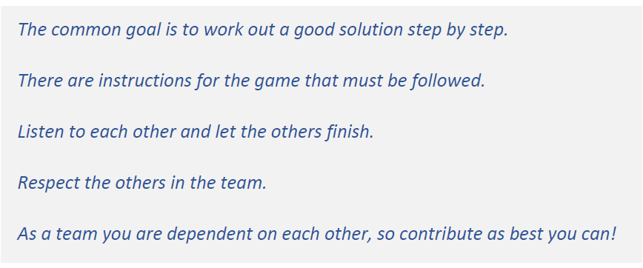
ACT-Game
Create teams of five pupils
Sit around a table

Slide 7
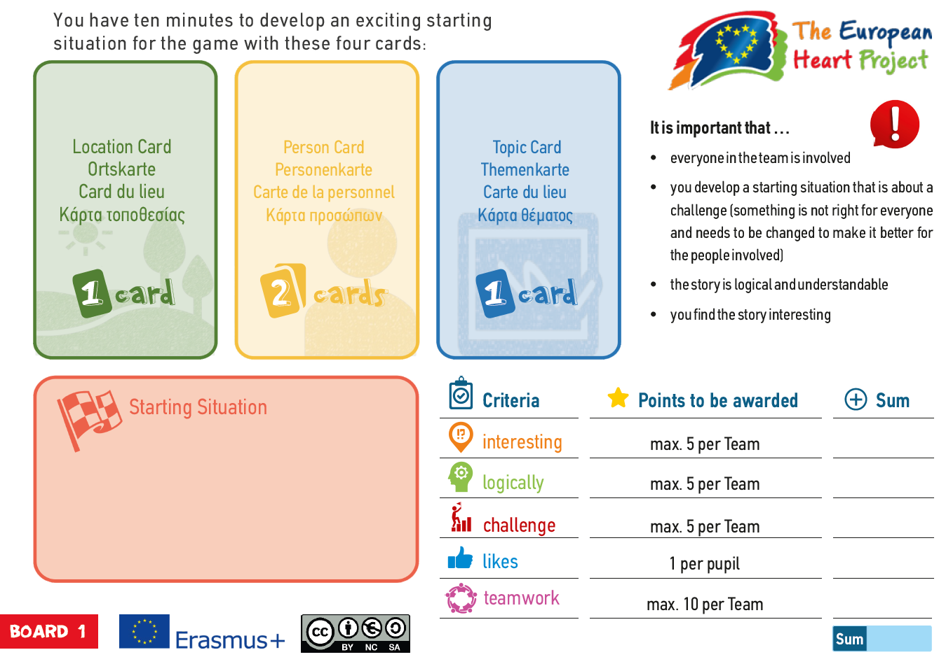
Board for Level 1
Draw two cards out of the pile of the person cards and one card of each of the other two piles.

Slide 9
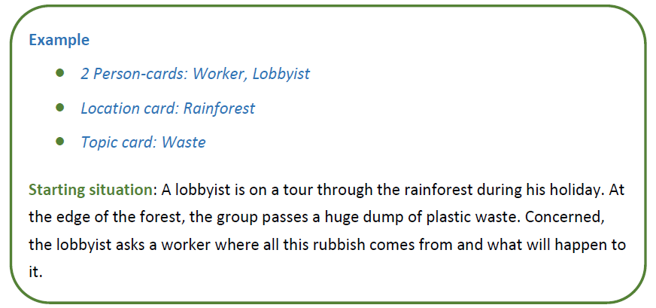
The challenge comes from the mixture of the cards drawn, the imagination and the knowledge of the teams.

Slide 10
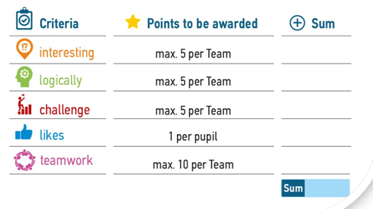
Evaluation
Every team presents their story to the others. After a team has presented its starting situation, it receives points from the other teams .

Slide 11
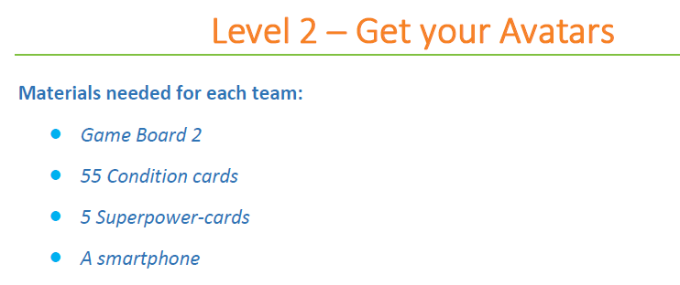

Slide 12
Board for Level 2

Slide 13
The teams have 10 minutes to awaken 5 avatars and get their superpower. Each team gets one Game Board 2 and a staple of 55 condition cards. Pupils shall mix the staple and put the with the backside up on the table. The Superpower cards are placed aside for the moment. They come into play one after the other as soon as the corresponding box on the Game Board is reached.

Slide 14
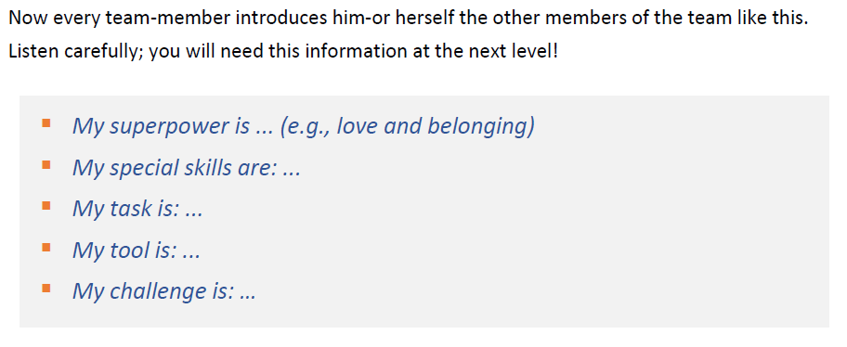
When you have reached the top field, you awaken the corresponding avatar and get the respective Superpower card. This avatar passes his or her abilities to the team member who correctly assigned the top card.

Slide 16
Board for Level 3

Slide 17
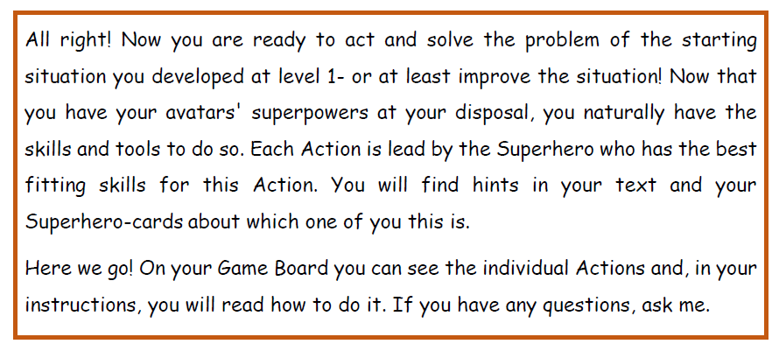

Slide 20
Board for Level 3

Slide 21
In this first Action pupils shall empathise with the involved persons to acquire a more holistic view of the situation. This will serve as a starting point for further actions.

Slide 22
Which persons are involved?
The team has to identify the three to four most important persons in their starting situation. Persons involved can be the actors from the person cards, but also others.
Pupils can think of persons who are directly affected by the situation, stakeholders, profiteers and decision makers. They may need help to choose the most important 3-4 persons in this Action.
When the team chooses a group of people to be involved, they should think of one person who gives a voice to this group.

Slide 23
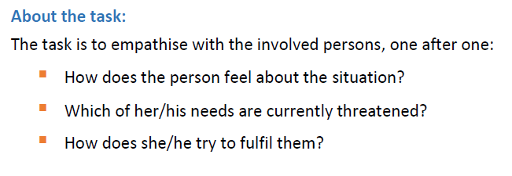

Slide 24
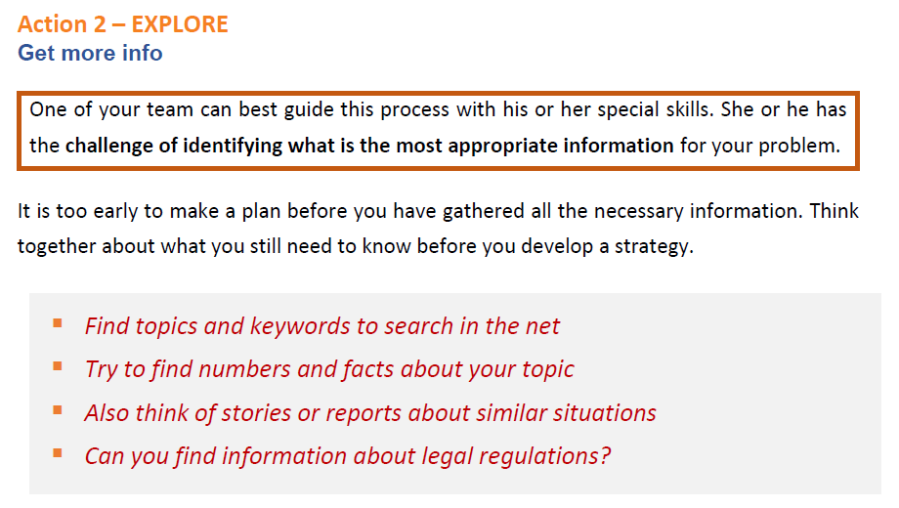
In this Action, pupils shall gather more info about the situation.

Slide 25
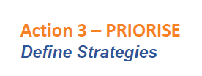

Slide 27
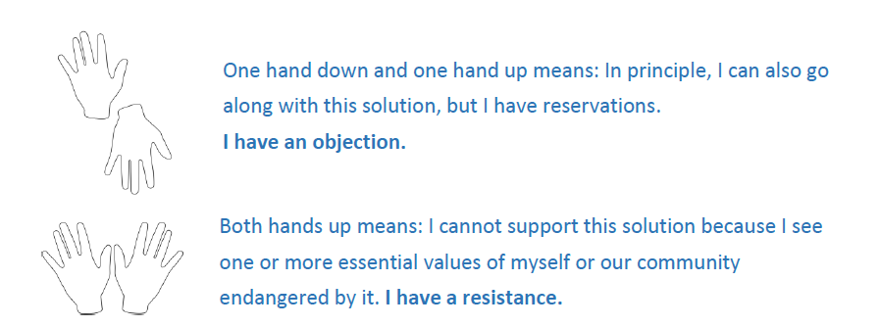

Slide 28
