Slide 1



Let's learn from history ...
Episode 4
The discovery of vanilla by a little former slave
The European Commission support for the production of this publication does not constitute an endorsement of the contents which reflects the views only of the authors, and the Commission cannot be held responsible for any use which may be made of the information contained therein.

Slide 2
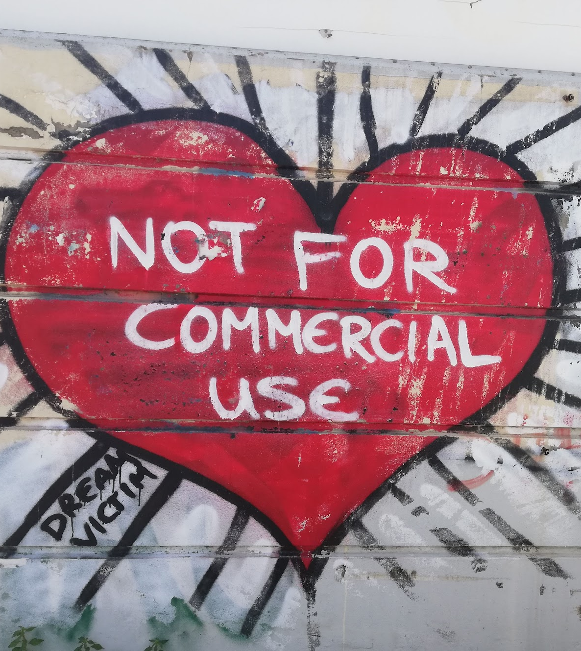
Declaration on Copyright
This work is licensed under a Creative Commons Attribution-NonCommercial-ShareAlike 4.0 International License. You are free to:
share — copy and redistribute the material in any medium or format
adapt — remix, transform, and build upon the material
under the following terms:
Attribution — You must give appropriate credit, provide a link to the license, and indicate if changes were made. You may do so in any reasonable manner, but not in any way that suggests the licensor endorses you or your use.
NonCommercial — You may not use the material for commercial purposes.
ShareAlike — If you remix, transform, or build upon the material, you must distribute your contributions under the same license as the original
Picture: Photo taken by Pantelis Balaouras, CC-BY-NC-SA.
Graffiti by Dream Victim.

Slide 3





Partners
Diefthinsi Defterovathmias
Ekpedefsis Anatolikis Attikis

Slide 4
Introduction

Slide 5

Welcome!
Hint 1: If you have not yet heard about the basic needs according to William Glasser's concept, you should first familiarise yourself with the booklet "Needs and Strategies", because this knowledge is already taken as a basis here.
In this booklet you can put into practice what you have learned so far about basic human needs and about helpful and less useful strategies.
Here you have the opportunity to experience history in a completely different way: Historians from Austria, Greece and France have worked intensively on the topic of what we can learn from the history of Europe. They have described exciting episodes from the perspective of the 5 basic needs. You have the chance to slip into the roles of the people involved and experience the scene from their individual point of view!
Hint 1
Hint 2
Hint 2: Υou can always refer back to the booklet "Needs and Strategies" if you are not sure about one or the other question. This is not a test or a school assignment. You can also do your history experience in pairs with a friend and talk to him or her in between.

Slide 6
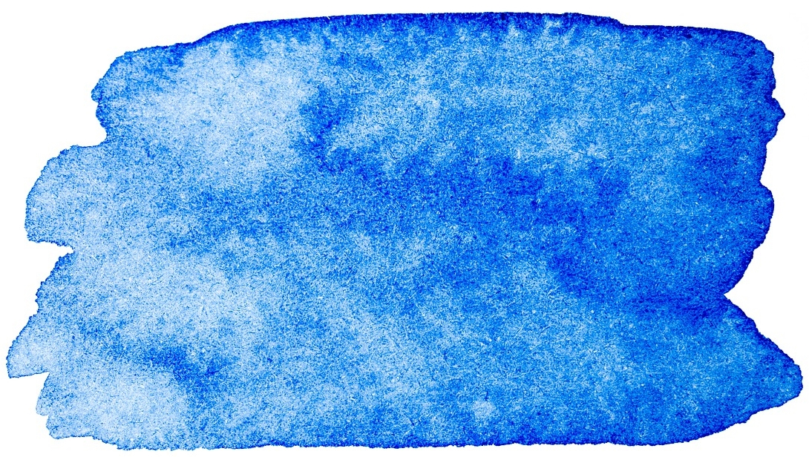
Milestones in the history of mankind (1)
What do we mean when we say milestones or turning points?
We wanted to discover History in a completely different way and change the traditional way of learning this subject.
So, that you can experience these fundamental decisions as vividly and intensively as possible, historians from Greece, France (La Reunion), and Austria have come together and compiled their knowledge:
  How and under what circumstances people lived at that time
  What image they had of the world
  What they believed in

Slide 7
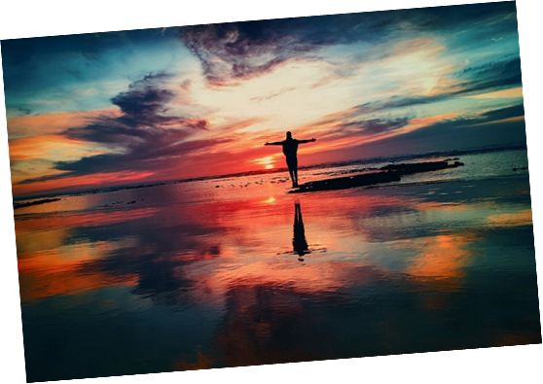
Milestones in the history of mankind (2)
What we cannot know is how they personally felt and what they thought. And this is where you come in: the second part of this booklet is about bringing the people who acted at that time back to life by putting yourself in their shoes.
Thus, do you want to try, new experiment with us

Slide 8
How to use this booklet (1)
Join us and travel with us into the past!
Get ready for this trip into the past and learn history from new perspectives! In this part you will discover a chosen episode in which the course was set for great changes.
First, familiarise yourself with the historical background of the episode (Step 1). There you can find out about the living conditions of the people who lived in the place where the episode happened at that time.
In the chapter "The Situation" you will find a description of the challenge the people faced.

Slide 9
How to use this booklet (2)
And now you can already take action:
  In the chapter "The people involved“, different people who were at the place of the event at that time tell you about the situation from their point of view.
Choose one among these persons from your historical experience.

Slide 10
The individual steps

Slide 11

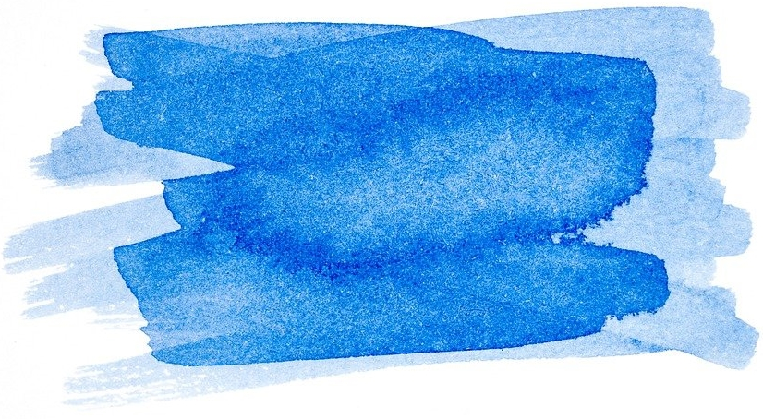

Step 1: Get familiar with the situation
Read / Listen
  the description of the episode
  and the situation carefully.
Do not hesitate to ask your teacher if you are unsure or have further questions of understanding. You can also do further research on the internet if you are particularly interested in a topic.
Description
A twelve-year-old slave boy Edmond discovered how to manually pollinate vanilla. No botanist or scientist before him has achieved this discovery, which will propel the cultivation of Bourbon vanilla throughout the world. Initially fertilized by specific insects in America, it could not give pods before the discovery of Albius because such fertilizing insects did not exist on the island.

Slide 12
The Situation
What you should know about this time, we are in Bourbon Island (Reunion) a small island in the Indian Ocean at a district called Sainte-Suzanne, in 1841. The company in this small French colony was based on the plantation economy supported by the system of slavery. Since the beginning of the 19th century the island has changed its economic orientation with the exploitation of sugar cane instead of coﬀee and spices, a more lucrative crop.
The story starts here, with a plant.
This is a vanilla plant It’s a kind of vine. It climbs, sometimes way high, and when it flowers and is visited by a pollinator, it produces a bunch of long, stringy beans. Properly treated, those beans give off the flavor we associate with vanilla.
When Spanish explorers brought vanilla from Mexico, it was mixed with chocolate and became a classy sensation, fancied by kings, queens, and, pretty soon, everybody else.
Demand, naturally, shot sky high. By the late 18th century, a ton of Mexican vanilla was worth, “its weight in silver.”
With profit margins growing, a few plants were hustled out of Mexico to botanical gardens in Paris and London, then on to the East Indies to see if the plant would grow in Europe or Asia.
It grew, but it wouldn’t bear fruit, wouldn’t produce beans. Flowers would appear, bloom for a day, fold up, and fall off. With no beans, there could be no vanilla extract, and therefore nothing to sell. The plant needed a pollinator. In Mexico a little bee did the deed. Nobody knew how the bee did it.

Slide 13
The Situation (cont.)
What can be done? In the 1790s people knew about plant sex. Bees, they knew, were pollinators. If people could only figure out where vanilla’s sexual parts were hiding, they could become bee substitutes.
They kept on trying. One plantation owner, , on the island of Réunion halfway between India and Africa, Ferréol Bellier-Beaumont had received a bunch of vanilla plants from the government in Paris. He’d planted them, and one, only one, held on for 22 years. It never bore fruits!
It is important to show the oppressive and sordid atmosphere of slave condition but sometimes also, a relationship of trust is developed with masters and must also be approached in parallel with the loneliness, the violence, and the exclusion. Above all in this case, we must consider the non-recognition of discoveries made by a slave by the society of this time. It seems necessary to highlight the miserable death of this free man despite the wealth that his discoveries have brought to this island.
The story told is the one of Edmond Albius. whose nickname was «Ingenious little devil", he was born a slave in 1829, in St. Suzanne, on the Réunion island. His mother died during childbirth, and he never knew his father. In his youth, he was sent to work for Botanist Ferréol Bellier-Beaumont. a wealthy farmer. Edmond became an apprentice of this botanical enthusiast and more precisely in his favorite field orchids.
The little slave was very passionate by this study, he was very curious and observant.

Slide 14
The Situation (cont.)
Every day the pair of them surveyed the culture of orchids with a scientific approach: Mr. Ferréol tried to put into practice the many scholarly knowledge emanating from his botany books and Edmond actively supported him in this thirst for knowledge and practice. In this quest for discovery, Edmond also did not hesitate to manipulate and to lift the diﬀerent parts of the vanilla flower as soon as he had a little moment of stolen freedom. He was fascinated by it, he felt that this flower had not revealed itself completely. One day, to his great surprise Mr. Ferréol saw the vanilla bean on one of the orchid he couldn’t believe his eyes.
Then, the child explains to him that it was, he, who fertilized the flower, but the master refuses to believe him. Three days later, he sees a second pod near the first one.
In front of him, and to prove his point, Young Edmond, performs the delicate operation of applying the anther with the pollen, a male organ, to the pistil, a female organ, his master introduced him to all the large estates owners so that he could teach his knowledge.
In 1848, after the abolition of slavery in Reunion, Edmond was freed and received his name as a free man: Albius, probably in reference to the white “alba” color of the vanilla flower.
Like most former freed slaves, Edmond left his master to start his own new life. He became a cook's helper for an oﬃcer. But life was tough and the wage miserable. Albius was involved in a story of jewelry theft and sentenced to jail for five years! At the request of F. Bellier and thanks to the leniency of a compassionate Justice of the Peace and Governor Hubert De Lisle, he was released for good behavior in 1855 after three years of hard labor.
The colony never showed its gratitude to him. He ended his life in 1880, at the Sainte- Suzanne hospice, in total destitution.

Slide 15

Step 2: Choose a person in whose footsteps you want to step
Each of the persons described has written history in his or her own personal way. With their decisions and strategies, all the people involved have had an influence on future events.
Of course, many, many more people were involved. We have chosen these four for you because it is important to us to give a voice not only to the rich and powerful, but also to those who have had less of a voice in the historiography up to now. After all, everyone bears the consequences of the decisions made at this time.

Slide 16
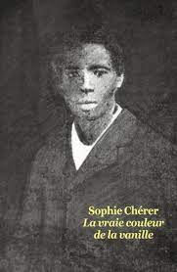
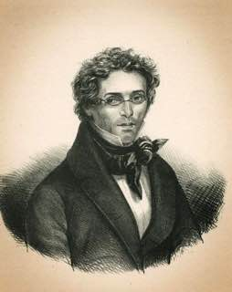
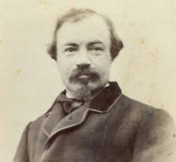
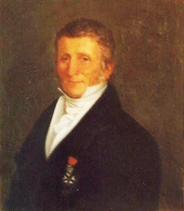
The involved Persons
Edmond Albius |  | Ferréol Bellier Beaumont
 | Young slave at Féréol Bellier Beaumont domain, he discovered how to pollinate vanilla. |  | Landowner passionate about botanic, particularly of orchids. When a slave of his sister died in childbirth, he decided to take the newborn child with him: Edmond.
Eugène Volcy Focard |  | Jean-Michel Claude Richard
 | Justice clerk, he took defense of Edmond Albius in 1863 when Jean Michel Claude Richard attempts to get credit of the fatherhood of Edmond’s discovery about vanilla pollination. |  | He was a noted French botanist and was the director of the Jardin du Roy on Bourbon island. He claimed to have discovered the process of artificial insemination.

Slide 17
Choose one of these four persons
Whose footsteps you would like to step into?
Choose one of these four persons and read the text below as she or he describes her or his situation.
Attention! Please read only the text that belongs to the person you have chosen and then go on to step 3

Slide 18
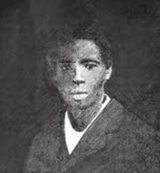
Person 1: Edmond Albius
Hi! I’m Edmond. Edmond was the first name given by my mother’s mistress; it was her uncle’s one.
I did not know my mother who died giving birth to me. Monsieur Féreol took me with him on his property. I was raised by Angata an old Bengalia woman who was a slave and belonged to my mother's mistress.
I wish I had known my mother, I often dreamt of the hugs she would have given to me but… "Life is difficult for us slaves, and happiness is not for us," Angata kept on telling me. "You have to make yourself invisible, blend into the scenery like the chameleon on the branch if you don't want to have problems." She was really rough Angata, fair but rough.
Monsieur took a good care of me. He allowed me to play with his children in the house and I could even have their dinner’s leftovers. Nevertheless, he did not hesitate to remind me of my condition. When I laughed too much he called me wild; when I wasn't quick enough to do my chores he would beat me saying that he didn't know why he agreed to take me in his home, and that he should have let me die…So I really grew up believing that I came from a background of bad people as he also used to say.
Hi! I’m Edmond. Edmond was the first name given by my mother’s mistress; it was her uncle’s one.
I did not know my mother who died giving birth to me. Monsieur Féreol took me with him on his property. I was raised by Angata an old Bengalia woman who was a slave and belonged to my mother's mistress.
What I liked most was when he took me to the fields There, he showed me the plants, told me about them and explained how they were fertilized. He even explained to me fertilization of pumpkin flowers. It was very interesting and truly extraordinary! I really liked that! But I still wonder why he was doing this. Maybe he finally had some affection for me So sometimes when Monsieur's children were studying with Monsieur Gillot the teacher, I ran through the fields to observe flowers. One day, I tried to fertilize the flowers of monsieur's favorite orchid. Every day when we passed in front of them, Monsieur used to stay there for a long time and admired them. He often said that the plants did not bear fruits and each time he was saddened by this fact but hoped that’s somehow, he will succeed in making grow vanilla and he used to say “haste make waste”. He had brought them back from a trip to America a few years earlier. I too, also found these white flowers so beautiful… and they smelled so good!
A week later while passing in front of them I noticed that the flowers had given way to a small green tube. I noticed it first and, proud of myself, showed him the plant. "Finally!" he exclaimed and he jumped for joy!
Further down the way, I confessed to him that it was I, who applied the technic he had taught to me. And I felt strong, very important. I, the poor little negro, had succeeded where all these big owners had failed. But he didn’t believe me at all and even howled with laughter. "You? the little negro!! stop making me laugh... Oh Edmond! You a negrillon botanist, hahaha". I should have expected it. I was mortified. His words hurt me. In the evening, during the meal Angata lectured me harshly, pulling my ears. "What did I tell you Edmond? Invisible... you go ahead of big troubles and big disappointments. The next day Monsieur himself came to pull me out of bed. "If this is really your work then show me how you did it." I got up and followed him to the fields. As I approached my fingers towards the delicate flower, he warned me that if I broke the flower I would be whipped, but he was intrigued by my persistence, and he let me do it… "And that's it! just wait, master". We waited. Then two weeks later, while the first famous pods, (as Monsieur called them), grew, the vanilla came out of the flowers. Seeing his smile on his lips and his eyes shining I felt so victorious. able to do great things. After all, negroes could be capable too.to enjoy its sweetness.
Monsieur was stunned. He leapt, shouted to anyone who wanted to hear him that his little Edmond was a genius. He took me in his arms, hoisted me on his shoulders, and we went back home. When the pods turned brown, he picked them, dried them, and showed them to his neighboring friends. I then taught him the gesture of fertilizing the orchid. He wanted to take me to meet other settlers so that I could show them how to fertilize vanilla. We went from property to property for weeks. At some owner’s I was very well received, I was even given sugar and sweets.
I was despised and I was harshly pushed aside once the gesture was understood.
Click A
Click B
Click C
Click D

Slide 19
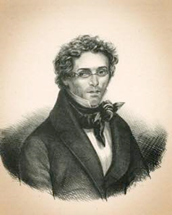
Person 2: Ferréol Bellier Beaumont
Hi! I am Fereol Bellier Beaumont, landowner of the largest house in the Sainte-Suzanne district, on the Bourbon island colony, to the south-west part of the Indian Ocean. I am not just a settler; I am one of the richest and most respected one. I would have made my father proud of me if he were still alive. I grow sugar cane on most of my properties but also some coffee, corn, cloves. I also belong to the Colonial Council, whose meetings I presided over for two years. These debates are not really fun but having a place in them ensures notoriety and power. And then it allows me to avoid some boring dinners that my wife likes to organize every week in company of these Lazarist brothers.
Fortunately, I am a passionate botanist and I’m keen on orchids. I brought back dozens of varieties from my travels. I love seeing them bloom. All these colors brighten my mood. I would spend hours watching them. Among these orchids I brought back one from America, named vanilla. It is a liana that offers such a delicate flower of a soft white and green. My plants had been given to me by Don Alejandro. In principle the plant provides fruits in the form of brown sticks Once dried they are used for pastries. Sieur Smith de Saint-Paul explained to me recently that his great aunt perfumed his English creams.
Hi! I am Fereol Bellier Beaumont, landowner of the largest house in the Sainte-Suzanne district, on the Bourbon island colony, to the south-west part of the Indian Ocean. I am not just a settler; I am one of the richest and most respected one. I would have made my father proud of me if he were still alive.
But to my great despair, the insects responsible for fertilizing the flowers of this orchid do not exist in the colony. Every year I contemplate its flowers and I lament when they go off. I had resigned myself. At least the flowers were beautiful! I resigned myself until Edmond my little negro boy told me that he had succeeded in reproducing the work of the insects. Needless to say, that I did not believe him for quite a moment. But during one of our walks, I found that there was a pod in formation. I couldn't believe my eyes. Edmond kept on saying that he was the author. I was torn between the happiness of what the sight of the pod gave me and the desire to pull the ears of this little scoundrel. I then chased him quickly with a slap in the head. at dawn I went back to the fields the next morning and summoned him to follow me and show me his technique if he was really the author.
I had to face the evidence when having reproduced the appropriate gestures several days later I saw the pods form. My joy was immense. I danced on the spot, laughing out loud and carrying Edmond on my shoulders.
Beyond the pleasure of this success, I quickly glimpse the possibilities that this discovery will bring me. One more recognition and economic power of course.
Click A
Click B

Slide 20
Person 3: Eugène Volcy Focard
I am Eugène Volcy Focard. I had a long career as Clerk of Justice in the Bourbon Island colony. I arrived in this remote colony in the hope of owning a plot of land I also wanted a life without any hitches It is well known that the Parisian world of the court is tough. people are ready for any low blow to succeed in their careers. There I just wanted to start a loving family and be able to give my love to a woman and children.
One of the cases I remember the most is the one in which I had to defend the named Edmond Albius, a free colored man, in 1863. He once showed up in front of me as I was on my way home. He was clothed in rags and had an emaciated face. I therefore felt a deep sadness. I listened attentively to him, he spoke Creole, this language invented by the former slaves and which the settlers were beginning to adopt. I wondered then what our slave society had done to these poor men.
He required my help to defend him in a court case. The latter, who was then still a slave of Monsieur Ferréol Beaumont, had discovered how to fertilize the vanilla flower, and thanks to this discovery made the fortune not only of his former master but also of the entire colony. Jean Michel Claude Richard wanted to claim the authorship of this discovery. It was then obvious that the case seemed lost in advance given the situation of the colored men on this island of Reunion. Nevertheless, I wanted to help him. Thus, what could have been the result of this case, I believed that I was participating in my own way to wash away the shame and horror that my peers had committed against these people of color.
In the end, wasn't the real power there?
I am Eugène Volcy Focard. I had a long career as Clerk of Justice in the Bourbon Island colony. I arrived in this remote colony in the hope of owning a plot of land I also wanted a life without any hitches It is well known that the Parisian world of the court is tough. people are ready for any low blow to succeed in their careers. There I just wanted to start a loving family and be able to give my love to a woman and children.
Click A

Slide 21
Person 4: Jean-Michel Claude Richard
I am the Sieur Jean Michel Claude Richard. I arrived in the colony at the end of 1831 to take on the task of botanist from the King's garden in the Saint-Denis district. I belong to a family of Bordeaux merchants and I chose this distant colony to find honor, power and why not, fortune.
The garden is located in the heights of the city and the place was suitable for the multispecies cultivation. When I took over from Sieur Bréon, the King's garden located in the heights of Saint- Denis was not very full. I loved my job. this work has made me feel good
Over the years I have managed to import more than 3000 species into the island and enhance this garden. Each time I returned to the island with new species, I was in the spotlight: a party was organized for me, and I was invited to the salons of the rue de l'Eglise, the rich owners of Saint- Paul and Sainte Suzanne asked me to instruct their children in botany. I loved this atmosphere more than anything.
The only shadow on my life: I could not find a way to fertilize a plant. It is an orchid that produces pods used in gastronomy. For their pastries and kitchens, the whole of Paris snatched it. If only I could produce it without the insects, I will definitely be the king of the colony.
I am the Sieur Jean Michel Claude Richard. I arrived in the colony at the end of 1831 to take on the task of botanist from the King's garden in the Saint-Denis district. I belong to a family of Bordeaux merchants and I chose this distant colony to find honor, power and why not, fortune.
I have written to other botanists in Santo Domingo and the American colonies, but none of them have ever been able to instruct me on this. Their work was at the same point as mine. The worst came when I heard that Monsieur Ferréol, a settler from Sainte-Suzanne, boasted that one of his negroes had taught the technique to the other owners. Nonsense! an inferior being could not be at the origin of such a discovery! However, this story got me curious...and I decided to go to the property.
When this little negro was introduced to me at Monsieur de Villentroy as the true discoverer of vanilla fertilization, I was angry. There was no question of me letting this little negro steal the show. It was for me more than a question of reputation; it was about my survival. So, I have claimed the authorship of this discovery saying that as I had often visited Mr Fereol Beaumont the black boy must certainly have seen me doing the fertilization.
After all, his technique was close to my own tests and he has only been lucky. A few more manipulations and I too would have achieved this result.
Click A
Click B

Slide 22
How history goes on (1)
One morning in 1841, Bellier-Beaumont was walking with his young African slave Edmond when they came up to a surviving vine. Edmond pointed to a part of the plant, and there, in plain view, two packs of vanilla beans were hanging from the vine. Two! That was startling. But then Edmond dropped a little bomb: This wasn’t an accident. He’d produced those fruits himself, he said, by hand-pollination.
Bellier-Beaumont didn’t believe him—not at first. It’s true that months earlier the older man had shown Edmond how to hand-pollinate a watermelon plant “by marrying the male and female parts together,” but he’d had no success with vanilla. No one had. But after his watermelon lesson, Edmond said he’d sat with the solitary vanilla vine and looked and probed and found the part of the flower that produced pollen. He’d also found the stigma, the part that needed to be dusted. And, most important, he’d discovered that the two parts were separated by a little lid, and he’d lifted the flap and held it open with a little tool so he could rub the pollen in.
Edmond had discovered the rostellum, the lid that many orchid plants (vanilla included) have, probably to keep the plant from fertilizing itself. Could you do it again, Bellier-Beaumont asked? And Edmond did.
This was such a big news! Bellier-Beaumont wrote his fellow plantation owners to say Edmond had solved the mystery, then sent him from plantation to plantation to teach other slaves how to fertilize the vanilla vine.
And thus, the Indian Ocean vanilla industry was born.

Slide 23
How history goes on (2)
In I841, there was no vanilla export. By 1848, it was exporting 50 kilograms (.0055 tons) to France; by 1858, two tons; by 1867, 20 tons; and by 1898, 200 tons. “By then,” Tim Ecott wrote, “Réunion had outstripped Mexico to become the world’s largest producer of vanilla beans.”
The planters were getting rich. What, I wondered, happened to Edmond? Well, he was rewarded. His owner gave him his freedom. He got a last name, Albius. Plus, his former owner wrote to the governor, saying he should get a cash tip “for his role in making the vanilla industry.” The governor didn’t answer. Edmond left his master and moved to town, and that’s when things went sour. He fell in with a rough crowd, somehow got involved in a jewelry heist, and was arrested, convicted, and sentenced to five years in jail. His former owner again wrote the governor.
“I appeal to your compassion in the case of a young black boy condemned to hard labor … If anyone has a right to clemency and to recognition for his achievements, then it is Edmond … It is entirely due to him that this country owes [sic] a new branch of industry—for it is he who first discovered how to manually fertilize the vanilla plant.”
The appeal worked. Edmond was released. But what catches my eye here is Bellier-Beaumont’s choice of “entirely.” Our new vanilla business, he says, is “entirely” due to Edmond. He’s giving full credit to the former slave for his discovery and retaining none for himself. That’s rare. Edmond was about to be recognized and paid.

Slide 24
How history goes on (3)
The appeal worked. Edmond was released. But what catches my eye here is Bellier-Beaumont’s choice of “entirely.” Our new vanilla business, he says, is “entirely” due to Edmond. He’s giving full credit to the former slave for his discovery and retaining none for himself. That’s rare. Edmond was about to be recognized and paid.
Then, suddenly, Edmond had a rival. A famous botanist from Paris—a scholar, a high official knighted for his achievements—announced in the 1860s that he, not the slave boy, had discovered how to fertilize vanilla.
Jean Michel Claude Richard claimed to have hand-pollinated vanilla in Paris and then gone to Réunion in 1838 to show a small group of horticulturists how to do it. Little Edmond, he presumed, had been in the room, peeked, and then stolen the technique. So, here’s a prestigious scholar from the imperial capital asserting a claim against a 12 year-old slave from a remote foreign island. What chance did Edmond have? He was uneducated, without power, without a voice….

Slide 25
Step 3: Instant History – Be the person
Now it is your turn!
You have already had experiences with the five basic needs and now it is a question of putting yourself in the shoes of people who were there at the time and were involved in some way. If all people have these basic needs, then we can assume that this was also the case back then, do you agree?
You now have the opportunity to help shape history as one of the actors of that time! The more you have familiarised yourself with the circumstances of the time in the previous chapter, the better you will be able to put yourself in the shoes of the person you chose and his or her circumstances.
When you do this, simply follow the guide in this chapter. It will guide you step by step through your historical experience. At the end of the chapter you will find out how the people involved actually decided and acted according to the history that has been handed down to them and what the consequences were.
click
Now it is your turn!
Put yourself as much as possible in the shoes of the person you have chosen and imagine that you are that person for this experience.
Now answer these questions:
  What does the situation you are in look like from your perspective?Describe in the first person what is currently on your mind. Start with: I am (e.g., I am Edmond I am Ferréol, …)
  Which people around you are in the same or a similar situation?

Slide 26
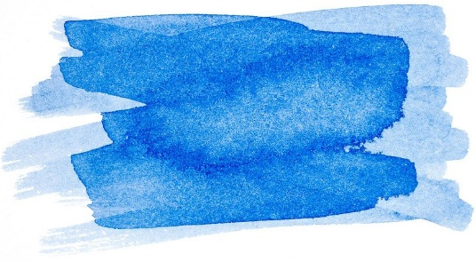
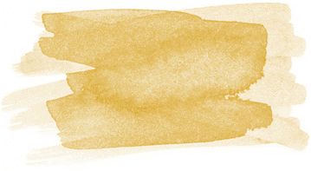
Step 4: How are you?
You are still in the role of your chosen person.
Now tell about your basic needs.
Take time to think and answer these questions:
Freedom:
  What options are there for you now?
Love and belonging:
  Who is in a similar situation as you are right now?
Survival:
  Is your life or safety endangered in any way? By what?
Power:
  What is particularly important to you now?
Fun:
  What options are there for you now?

Slide 27
Step 5: What would you do now?
How would you act now? Which of your needs would you most like to fulfil in this situation?
Freedom:
  What could you decide right now to improve your situation?
Love and belonging:
  How can you gain the trust of another person?
Survival:
  What can you do right now to feel safer?
Power/Influence:
  What could you do now that you would be really proud of?
Fun:
  What could you do to ease the situation?

Slide 28
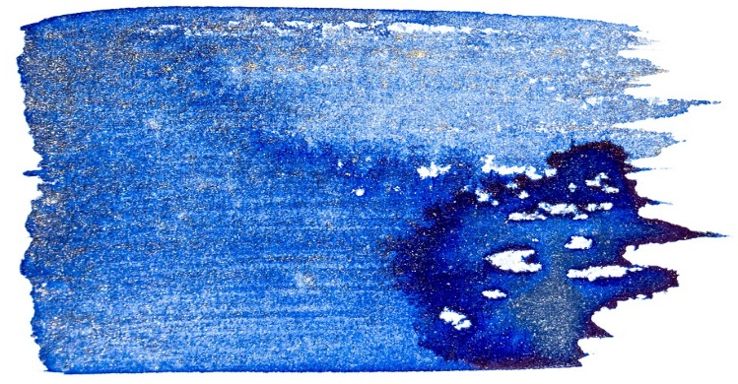

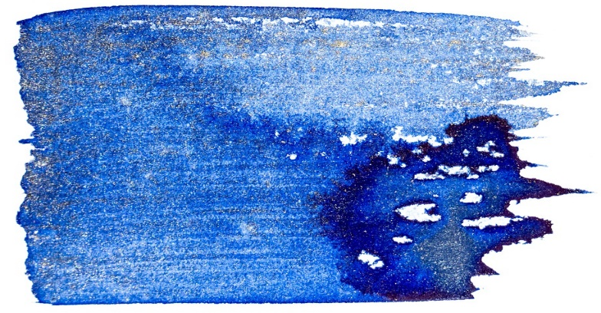

Step 6: Stopover!
If you want to know how the person you have now put yourself in the shoes of actually acted then, click on in the corresponding box:
But beware! Read only this one box, otherwise you will lose the excitement of the other characters
Box 1: Edmond Albius
Young slave at Féréol Bellier Beaumont domain, he discovered how to pollinate vanilla.
Box 2 : Ferréol Bellier Beaumont
Landowner passionate about botanic, particularly of orchids. When a slave of his sister died in childbirth, he decided to take the newborn child with him: Edmond.
Box 3 : Eugène Volcy Focard
Justice clerk, he took defense of Edmond Albius in 1863 when Jean Michel Claude Richard attempts to get credit of the fatherhood of Edmond’s discovery about vanilla pollination.
Box 4 : Jean-Michel Claude Richard
He was a noted French botanist and was the director of the Jardin du Roy on Bourbon island. He claimed to have discovered the process of artificial insemination.
click
click
Box 1: Edmond Albius
Box 2:
Rosa,
Maid of Honour
Box 3:
Eugène Volcy Focard
click
click
Box 4:
Jean-Michel Claude Richard

Slide 29
Step 7: Now you have the choice
Did you find it exciting to dive into the story and put yourself in the shoes of one of these characters?
If you have time and feel like it, you can now choose another person whose role you would like to play. So go back to Step 3 and choose who you want to be next.
If you decide you don't want to play another role in this episode, you'll find out what happened in the Greek story in the next chapter.

Slide 30
How the story continues
The end of the story
Once again, Edmond’s former master, Bellier-Beaumont, jumped into action, writing a letter to Réunion’s official historian declaring Edmond the true inventor. The great man from Paris, he said, was just, well, mis-remembering.
He went on to say that no one recalled Richard showing them how to fertilize orchids, but everybody remembers, four years later, Edmond teaching his technique to slaves around the island. Why would farmers invite Edmond to teach “if the process were already known?”
“I have been [Richard’s] friend for many years, and regret anything which causes him pain,” Bellier-Beaumont wrote, “but I also have my obligations to Edmond. Through old age, faulty memory, or some other cause, M. Richard now imagines that he himself discovered the secret of how to pollinate vanilla and imagines that he taught the technique to the person who discovered it! Let us leave him to his fantasies.” The letter was published. It’s now in the island’s official history. It survives.

Slide 31
How the story continues
And Yet… a Miserable End
Edmond himself never prospered from his discovery. He married, moved back to the country near Bellier-Beaumont’s plantation, and died in 1880 at age 51. A little notice appeared in “the Moniteur”, the local paper, a few weeks after he died. Dated Thursday, 26 August, 1880, it reads: “The very man who at great profit to his colony, discovered how to pollinate vanilla flowers has died in the hospital at Sainte-Suzanne. It was a destitute and miserable end.” His long-standing request for an allowance, “never brought a response. the obituary said,
This is such a rare tale. It shouldn’t be. But it is!

Slide 32
Learning from history
Now share your experience and reflections with your classmates:
How was it? Did you manage to put yourself in the situation and the persons' shoes?
Can you understand why they acted the way they did?
Would you have acted the same way?
What could have happened, if one of the characters acted in a different way? (Lambros: …, Rosa: …, Kallergis: …, Queen Amalia: …)

Slide 33
Learning from history
Further questions to make the most of your experiences and insights with the episode
For whom did the solution (as described in the chapter “How the story continues” make life better?
Were there also losers? Who were they? What did they lose?
Are there situations similar to this episode of history in our world at the moment?
What can we learn from this episode of history?

Slide 34
References
In children's literature and a bit of history
Chérer, Sophie. La vraie couleur de la Vanille, école des loisirs, 20142.
Niodème, Béatrice. Couleur vanille, éditions Gallimard, 20113.
Vaxelaire, Daniel. Chasseurs de noirs, Folio Junior, 1982
Sitography
https://www.reunionnaisdumonde.com/magazine/1001-celebrites/edmond-albius-l-enfant-esclave-et-la-gousse-de-vanille/
https://www.departement974.fr/actualite/commemoration-10-mai-sur-les-traces-dedmond-albius-2022
Cinema
Furcy: The Trial of Freedom, Pierre Lane, 2021
Digital print media
https://www.lequotidien.re/collectivites/departement-de-la-reunion/commemoration-du-10-mai-sur-les-traces-dedmond-albius/
https://clicanoo.re/rubriques/societe/2021/04/01/memorial-de-lesclavage-a-paris-edmond-albius-et-celimene-proposes-par-la-frheemaane
Place of Remembrance-
Edmond Albius Memorial and Stele: 1 chemin du Bocage, 97 441, Sainte-Suzanne

Slide 35
Congratulations!
You have completed this Episode!
The European Commission support for the production of this publication does not constitute an endorsement of the contents which reflects the views only of the authors, and the Commission cannot be held responsible for any use which may be made of the information contained therein.

